Slide 1
PERT Postsecondary Education Readiness Test

Slide 2
Usage
PERT is now only used for Dual Enrollment eligibility
Criteria set by Rule 6A-10.0315, F.A.C., adds the following categories of alternative methods and associated minimum standards for dual enrollment eligibility determinations, admissions counseling, and developmental education placemen
Reading (106)
Writing (103)
Mathematics (114)*
* MAC1105 requires a score of 121

Slide 3
Test Set Up
PERT is a three sub-test computer based test that is used to see how ready students are for college level courses
Each sub test has 30 questions
Once you click “submit” on a question, you cannot revisit that question
Handheld calculators are not allowed on the math portion – if the system thinks a questions needs a calculator, once will pop up on the screen
Students cannot use the “Enter” key on the keyboard to move to the next question – they must use the mouse and select the word “Next” on the screen and click

Slide 4
Test Set Up
PERT math
Students should have a good grasp of algebraic equations. You should be able to solve linear and quadratic equations as well as apply standard algorithms. You will be expected to manipulate polynomials and use coordinate planes.
PERT reading
Critical reading facilitates the PERT reading test. Students must be able to find the meaning in passages including the author's intent, the difference between fact and opinion, and be able to pull out key ideas.
PERT writing
Questions on the PERT writing test focus on grammar, sentence structure, and the ability to write cohesively. Synthesis of information, as well as key organizational and structural concepts, will be tested. You will also be expected to understand appropriate word choice and syntax.

Slide 5
Policies/Procedures
Training
New PERT test coordinators will need to be trained by Heather. Other school staff may be trained by school test coordinator.
Users
Test coordinators will have a Site Manager account
If you need access, email Heather Rykard
Security Agreements
All test administrators are required to sign the security agreement every year
Keep all test agreements at your campus and turn in with your PERT materials.
Notes:
Existing PERT coordinators who have been previously or newly trained MAY train others at the school. If you are not comfortable, I can come out to train.
Please sign your PERT agreement and leave it in the PERT Agreement folder on the sign in table.

Slide 6
Security/Invalidations
Proctor Rules
Proctor required if testing more than 30 students.
Windows - Vanguard Secure Browser
Login with CBTXXXX user and run secure browser
Secure Browser requires a password to exit
Chromebooks – security through login profile
Login with CBTXXXX user
Do not have students sign in with their own username
Invalidations
Tests administered without security measures will be invalidated
Notes:
If you have an invalidation, you must email the details (student name, ID, date of test, what happened) as we have to complete a written invalidation sheet and send to McCann Associates/.

Slide 7
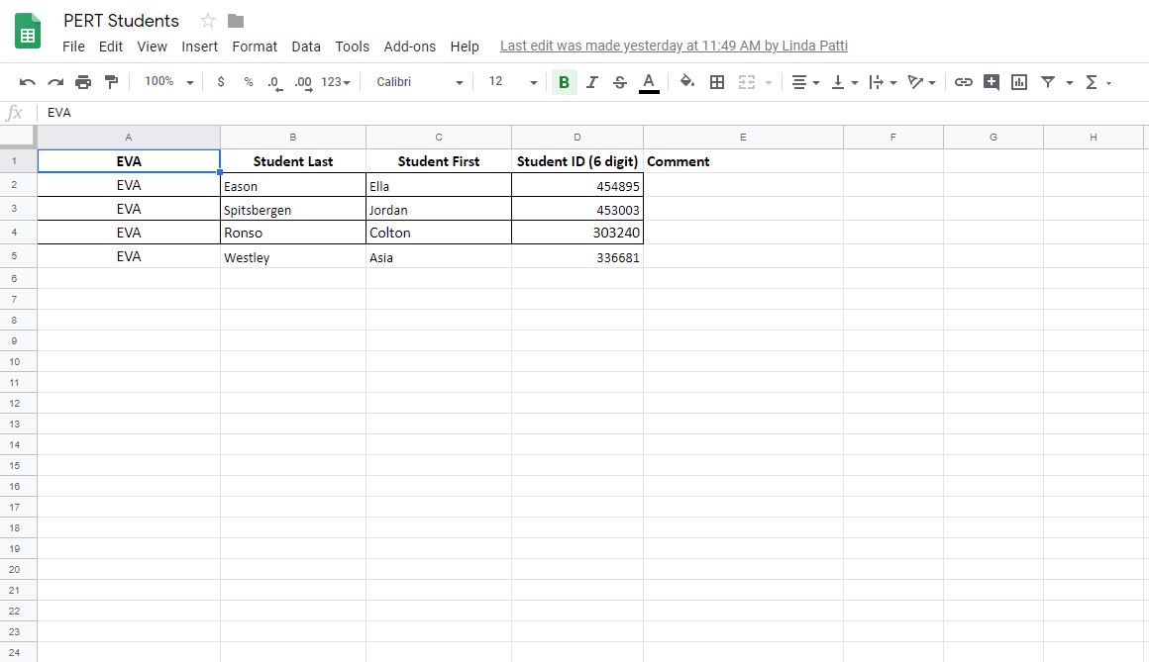
Before Testing
Student Upload Request Form
Enter student info on Google Doc at any time
Eval will upload twice a month (1st and 15th)
If you do not have access, email Heather Rykard
Notes:
Please ensure that you are entering correct student information – there can be multiple same named students. Last year, we had a student who passed the PERT, but the school had uploaded the incorrect student (7+ yr ago grad) with same name. Don’t forget that we do not delete students from your college success accounts.

Slide 8
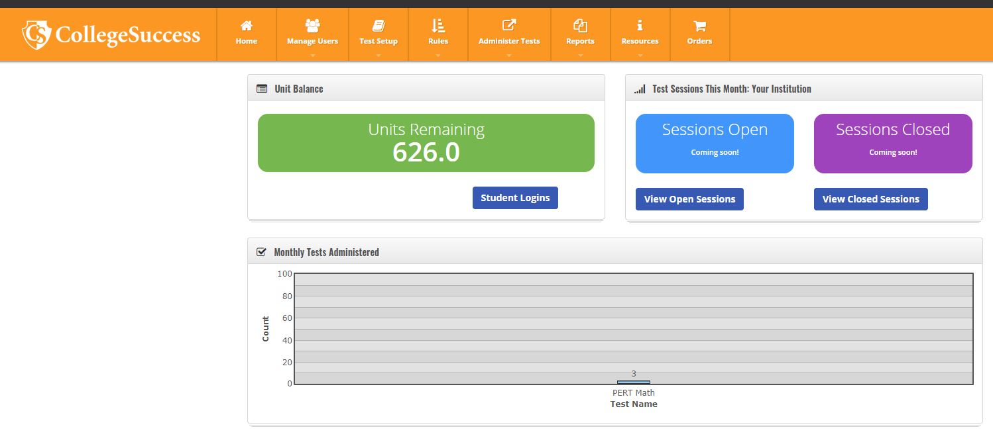
Before Testing
Testing Units
Check to make sure you have enough testing units
Found on your dashboard in College Success
Each subtest = 1 testing unit

Slide 9
Before Testing
Activate Students
Students are inactive when uploaded
Go to “Administer Tests” → “View and Export Student Logins”
Select students to activate by selecting the radial box by their name and choose the “Activate Students” button at the bottom of the screen

Slide 11
Test Day
Have students sign in upon entry
Ensure you make a seating chart – District required
Take up electronic devices
Make sure students have logged in with the CBTxxxx account, not their own (there will be a blue “V” in their Chromebook tray)
Read the script
Take up log in tickets once students are logged in
Make sure you are using correct month’s access codes

Slide 12
During Testing – Required Materials
Access Codes
Script
Authorization Tickets
Student Sign-in Sheet
Seating chart
Security Log
Math Scratch Paper
No handheld calculators
* All required items found on Evaluation Services webpage
Notes:
Heather will send out codes every month
Print tickets and have them ready for testing
TA’s collect tickets immediately after students log in – All pages are found on Evaluation services webpage under PERT

Slide 13
After Testing
Exit out of secure browser (windows)
This is a secure password and MUST NOT BE ENTERED BY THE STUDENT
Students may only test once a month
Students may only take each subtest once in a 30 day period. Please coordinate with guidance departments to keep up with outside PERT Referral Forms (used for PSC Testing).

Slide 14
After Testing
Secure items held at school until end of year
Security agreements
Authorization Tickets
Student Sign-in sheets
Seating charts
Security Logs
Math Scratch Paper

Slide 15
After Testing
You may run a report to show a student his/her score, if requested
Evaluation Services will upload scores into FOCUS – notify Heather and/or Scott that your school has completed testing

Slide 16
QUESTIONS?
Heather Rykard, TSA
850-469-5387
hrykard@ecsdfl.us

